Slide 1
Culorile

Slide 2
Roșu | Alb | Negru | Albastru | Galben
Verde | Portocaliu | Mov | Roz

Slide 3
Resurse
Toate - Funcția Cerc din Google Presentation

Slide 4
Anotimpurile

Slide 5




Primăvară | Vară | Toamnă | Iarnă

Slide 6
Resurse
Primavara - https://www.flaticon.com/free-icon/spring_2055470?term=spring&page=1&position=45
Vara - https://www.flaticon.com/free-icon/beach_422930?term=summer&page=1&position=34
Toamna - https://www.flaticon.com/free-icon/park_1965174?term=autumn&page=1&position=30
Iarna - https://www.flaticon.com/free-icon/snow_2204395?term=winter%20weather&page=1&position=70

Slide 7
Persoanele

Slide 8




Eu | Tu | El | Ea | Noi
Voi | Ei | Ele

Slide 9
Resurse
Eu - https://www.flaticon.com/free-icon/self-esteem_2804193
Tu - https://www.flaticon.com/free-icon/what-are-you-doing_2165768
El - https://www.flaticon.com/free-icon/avatar_2897023?term=boy&page=1&position=16
Ea - https://www.flaticon.com/free-icon/woman_1864609?term=girl&page=1&position=17
Noi - Combinații
Voi - Combinații
Ei - Combinații
Ele - Combinații

Slide 10
Acțiuni

Slide 11









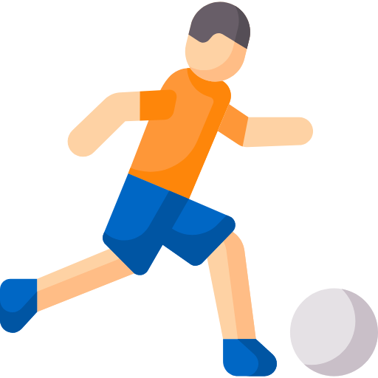





A vrea | A alerga | A vorbi | A plânge | A mânca
A cânta | A dansa | A dormi | A fi | A se juca
A saluta | A scrie | A iubi | A zâmbi | A citi

Slide 12
Resurse
A plânge - https://www.cleanpng.com/png-emoticon-smiley-computer-icons-crying-clip-art-eye-1341456/preview.html
A mânca - https://www.flaticon.com/free-icon/kitty_763722?term=eat&page=2&position=19
A cânta - https://www.flaticon.com/free-icon/singer_2318000?term=sing&page=1&position=25
A dansa - https://www.flaticon.com/free-icon/dance_1997712?term=dance&page=1&position=46
A dormi - https://www.flaticon.com/free-icon/sleeping_2906357?term=sleep&page=1&position=15
A fi - https://www.flaticon.com/free-icon/laugh_1006001?term=happy&page=1&position=42
A se juca - https://www.flaticon.com/free-icon/football-player_2817892?term=footbal&page=3&position=60
A saluta - https://www.flaticon.com/free-icon/greeting-man_76769?term=greet&page=1&position=86
A scrie - https://www.flaticon.com/free-icon/notes_1355663?term=write&page=1&position=14
A iubi - https://www.flaticon.com/free-icon/affection_2651001?term=happy&page=1&position=10
A zâmbi - https://www.flaticon.com/free-icon/smiling_2843254?term=smile&page=1&position=43
A citi - https://www.flaticon.com/free-icon/student_2302834?term=read&page=1&position=18

Slide 13
Resurse
A vrea - https://www.flaticon.com/free-icon/mission_2285663
A saluta - https://www.flaticon.com/free-icon/hello_2165693?term=hello&page=1&position=6
A citi - https://www.flaticon.com/free-icon/reading_948256

Slide 14
Sentimente

Slide 15








Tristețe | Fericire | Furie | Dor | Frică
Nerăbdare | Surprindere | Nedumerire

Slide 16
Resurse
Tristețe - https://www.flaticon.com/free-icon/anxiety_2036890?term=sad&page=1&position=43
https://www.flaticon.com/free-icon/sad_927561
Fericire - https://www.flaticon.com/free-icon/happy_742773?term=happiness&page=1&position=53
https://www.flaticon.com/free-icon/happy_1023656
Furie - https://www.flaticon.com/free-icon/anger_555680?term=anger&page=1&position=9
Dor/Lipsă - https://www.flaticon.com/free-icon/education_1763669
Frică - https://www.flaticon.com/free-icon/fear_2367069
Nerăbdare - https://www.flaticon.com/free-icon/impatient_708794?term=impatient&page=1&position=3
Surprindere - https://www.flaticon.com/free-icon/surprised_1240227
Nedumerire - https://www.flaticon.com/free-icon/confused_1698558?term=question%20mark&page=1&position=14
https://www.flaticon.com/free-icon/confused_2303937

Slide 17
Cuvinte de legătură
Cuvinte des întâlnite

Slide 18






Și / Cu | La / Către | Da | Nu | Aici
Acasă

Slide 19
Resurse
Și - https://www.flaticon.com/free-icon/link_1017466?term=link&page=1&position=9
La - https://www.flaticon.com/free-icon/arrows_507258?term=to&page=1&position=29
Da - https://www.flaticon.com/free-icon/positive-vote_1533908
Nu - https://www.flaticon.com/free-icon/negative-vote_1533914
Aici - https://www.flaticon.com/free-icon/location_1483336?term=location&page=1&position=62
Acasă - https://www.flaticon.com/free-icon/house_609803?term=home&page=1&position=6
https://www.flaticon.com/free-icon/home_2413074

Slide 20
Nevoi

Slide 21



Somn | Sete | Foame | Duș | Toaletă

Slide 22
Resurse
Somn - https://www.flaticon.com/free-icon/sleeping_2906357?term=sleep&page=1&position=15
Sete - https://www.flaticon.com/free-icon/drink-water_2906307?term=drink&page=1&position=12
Foame - https://www.flaticon.com/free-icon/kitty_763722?term=eat&page=2&position=19
Duș - https://www.flaticon.com/free-icon/shower_2228247?term=shower&page=1&position=30
Toaletă - https://www.flaticon.com/free-icon/toilet_578088?term=toilet&page=1&position=49

Slide 23
Alimente

Slide 24





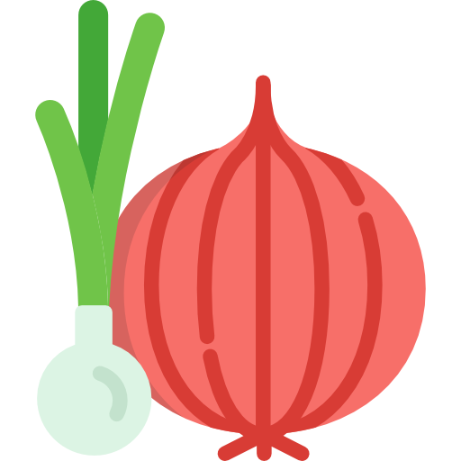







Supă | Salată | Carne | Fructe | Legume
Lapte | Ouă | Pâine | Cereale | Brânză

Slide 25
Resurse
Supă - https://www.flaticon.com/free-icon/soup_2255592?term=SOUP&page=1&position=67
Salată - https://www.flaticon.com/free-icon/salad_2843640?term=salad&page=1&position=87
Carne - https://www.flaticon.com/free-icon/roast-chicken_528157?term=meat&page=1&position=50
https://www.flaticon.com/free-icon/meat_2619468
Fructe - https://www.flaticon.com/free-icon/banana_1135549?term=fruits&page=1&position=28, https://www.flaticon.com/free-icon/cherry_766023?term=fruits&page=1&position=91, https://www.flaticon.com/free-icon/watermelon_2224249
Legume - https://www.flaticon.com/free-icon/carrot_424076?term=carrot&page=1&position=4, https://www.flaticon.com/free-icon/onion_424223
Lapte - https://www.flaticon.com/free-icon/milk_808842?term=milk&page=2&position=51
Ouă - https://www.flaticon.com/free-icon/egg_837560
Pâine - https://www.flaticon.com/free-icon/bread_2371995?term=bread&page=1&position=8
Cereale - https://www.flaticon.com/free-icon/cereals_2561508?term=cereal%20bowl&page=1&position=14
Brânză - https://www.flaticon.com/free-icon/cheese_836417?term=cheese&page=1&position=21
https://www.flaticon.com/free-icon/cheese_135421

Slide 26
Îmbrăcăminte

Slide 27

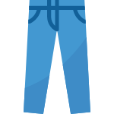







Tricou | Pantaloni | Pantaloni scurți | Lenjerie | Șosete
Bluză | Rochie | Pijamele | Geacă

Slide 28
Resurse
Tricou - https://www.flaticon.com/free-icon/shirt_2700495?term=t%20shirt&page=1&position=56
Pantaloni - https://www.flaticon.com/free-icon/jeans_776623?term=trousers&page=1&position=9
Pantaloni scurți - https://www.flaticon.com/free-icon/swimwear_2405637?term=shorts&page=1&position=16
Lenjerie - https://www.flaticon.com/free-icon/human-body_2906931?term=human&page=1&position=7
Șosete - https://www.flaticon.com/free-icon/socks_2226447?term=socks&page=1&position=13
Bluză - https://www.flaticon.com/free-icon/blouse_1360176
Rochie - https://www.flaticon.com/free-icon/dress_2290427?term=dress&page=1&position=48
Pijamale - https://www.flaticon.com/free-icon/pijama_1347677?term=pijamas&page=1&position=52
Geacă - https://www.flaticon.com/free-icon/varsity-jacket_2784493

Slide 29
Timpul

Slide 30




Ora mesei | Ora de somn | Ora de sport | Ora de artă | Ora de lectură
Ora de scriere | Ora de joacă

Slide 31
Resurse
Ora mesei - https://www.flaticon.com/free-icon/eating_2228252?term=eat&page=1&position=11
Ora de somn - https://www.flaticon.com/free-icon/sleeping_2906357?term=sleep&page=1&position=15
Ora de sport - https://www.flaticon.com/free-icon/gymnastics_906201?term=sports&page=2&position=27
Ora de artă - https://www.flaticon.com/free-icon/color-palette_2867973?term=paint&page=1&position=69
Ora de lectură - https://www.flaticon.com/free-icon/student_2302834?term=read&page=1&position=18
Ora de scriere - https://www.flaticon.com/free-icon/notes_1355663?term=write&page=1&position=14
Ora de joacă - https://www.flaticon.com/free-icon/jigsaw_993723?term=games&page=1&position=26

Slide 32
General
Dolar - https://www.flaticon.com/free-icon/dollar-symbol_2150150?term=dollar%20symbol&page=1&position=94
Bulina albastra - https://www.flaticon.com/free-icon/full-moon_1281225
Bulina galbena - https://www.flaticon.com/free-icon/full-moon_1281188

